Slide 1

BODY FINESS PREDICTION
Developed by:
Govindula sri sai ram 19UK5A0504
Nagavardhan Reddy Punnam 18UK1A0548
Lingabathini Sai Shashank 18UK1A0528
Poleboina Akshay Chandra 18UK1A0543
Mushika Sairam 18UK1A0535

Slide 2
TABLE CONTANT
Introduction
Overview
Software Designing
Block Diagram
Advantages and Disadvantages
Applications and future scope

Slide 3
INTRODUCTION
A gym trainer and monitoring system that has various workout regimes for weight gain and weight loss. Both these options have a trainer. On entering the weight gain trainer it asks for your body weight, height and other answers. Depending on that it calculates your body mass index. It then shows you a workout schedule depending on the amount of weight you need to gain from your current status. It then keeps monthly track of your BMI and completes the cycle when you reach your goal. Similarly the weight loss trainer trains and monitors your workout and provides appropriate training and results.

Slide 4
OVERVIEW
Sedentary lifestyle is defined by the absence of physical activity practices throughout the day and causes a decrease in caloric expenditure. This behavior is explained by the inappropriate lifestyle, for example, too much time sitting or lying down and still eating unhealthy foods during this time of immobilization. Currently, a third of the adult world population is physically inactive and this generates 5 million deaths per year (The LAncet, 2012). In addition to contributing to several chronic diseases, physical inactivity also influences mood, sleep quality and body weightThe objective of the project is answering a simple question, “does exercise/working-out improve a person’s activeness?”. For the scope of this project a person’s activeness was the measure of their daily step-count (the number of steps they take in a day). We are going to build a Machine Learning model which predicts the activeness or inactiveness of a person based on the Mood and number of steps taken in a day. Mood was measured in either "Happy", "Neutral" or "Sad" which were given numeric values of 300, 200 and 100 respectively. Feeling of activeness was measured in either "Active" or "Inactive" which were given numeric values of 500 and 0 respectively.

Slide 5
Software Designing
Jupyter Notebook Environment and Google Colab
Spyder Ide
Machine Learning Algorithms
Python (pandas, numpy, matplotlib, seaborn, sklearn)
HTML
Flask

Slide 6
Block Diagram

Slide 7
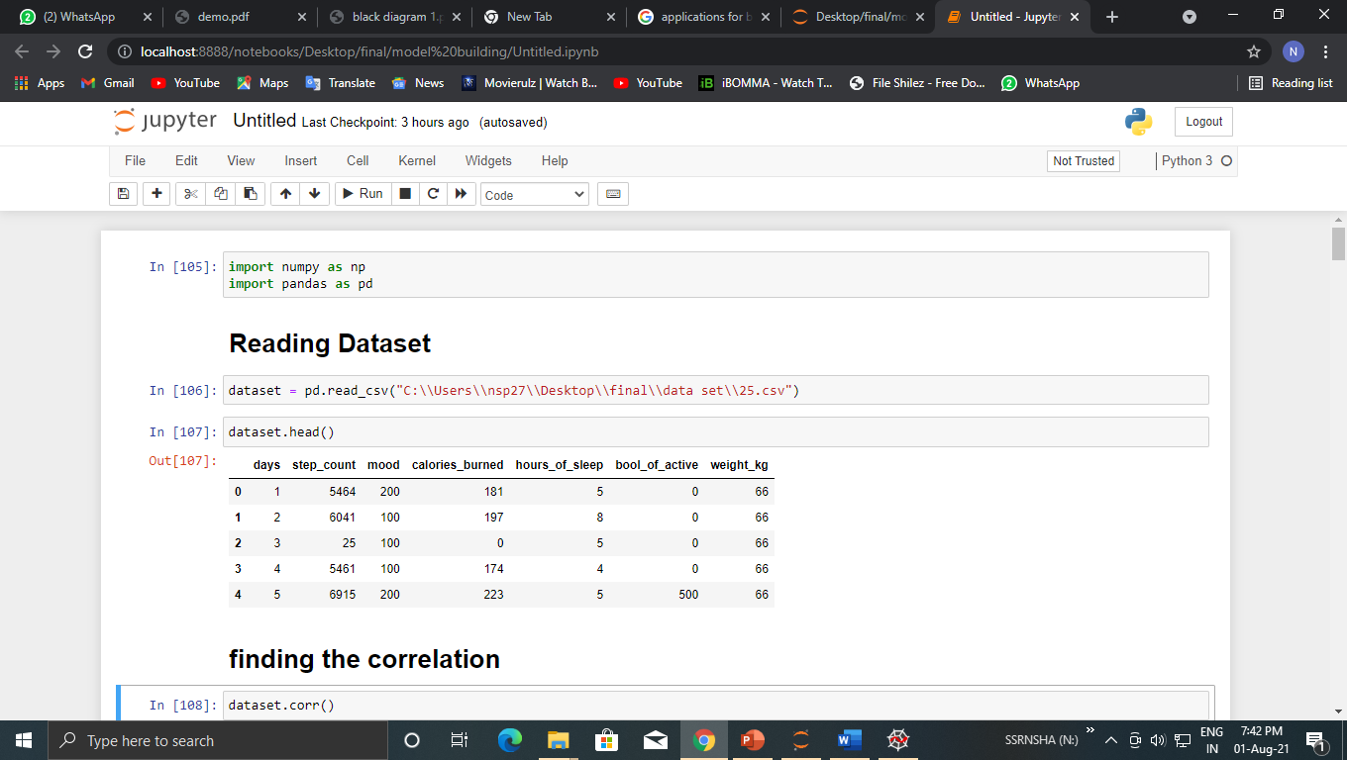

Slide 8
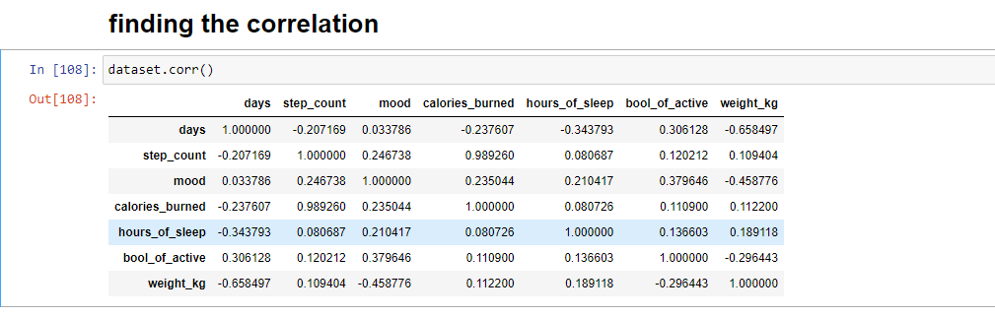

Slide 9
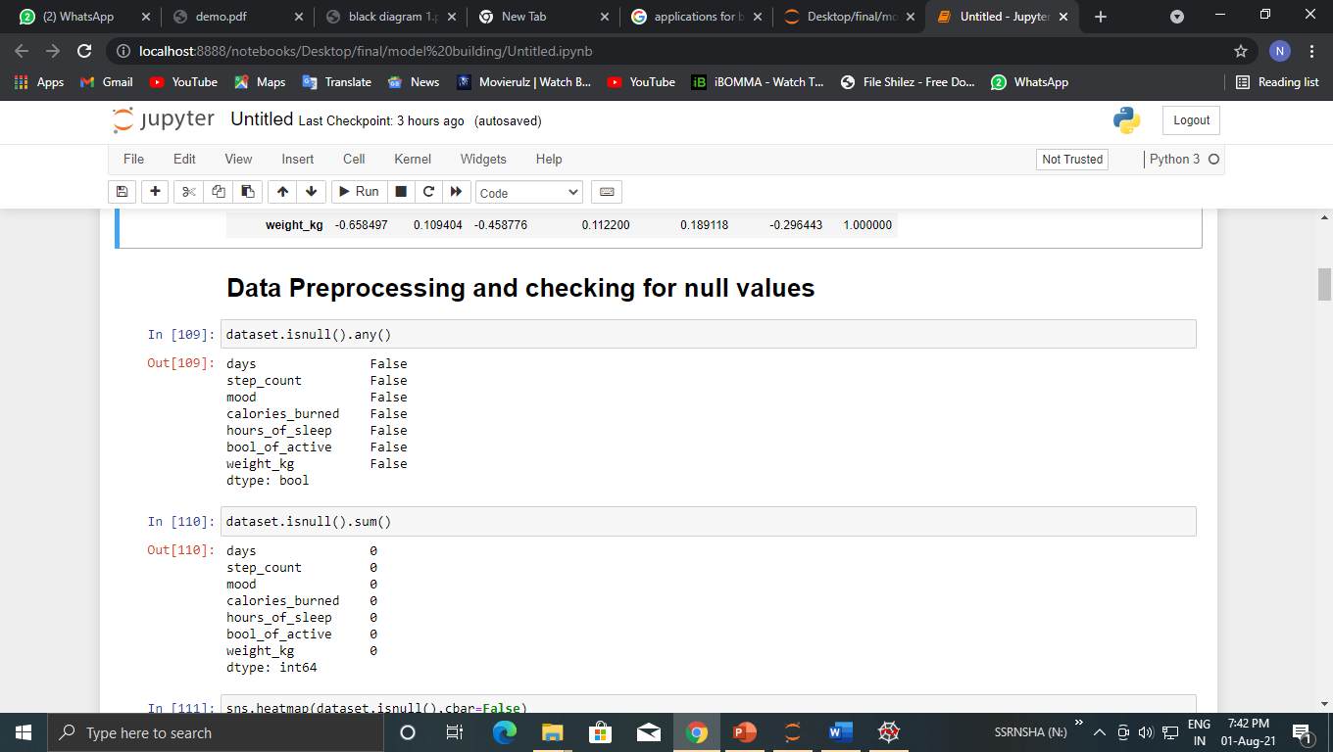

Slide 10
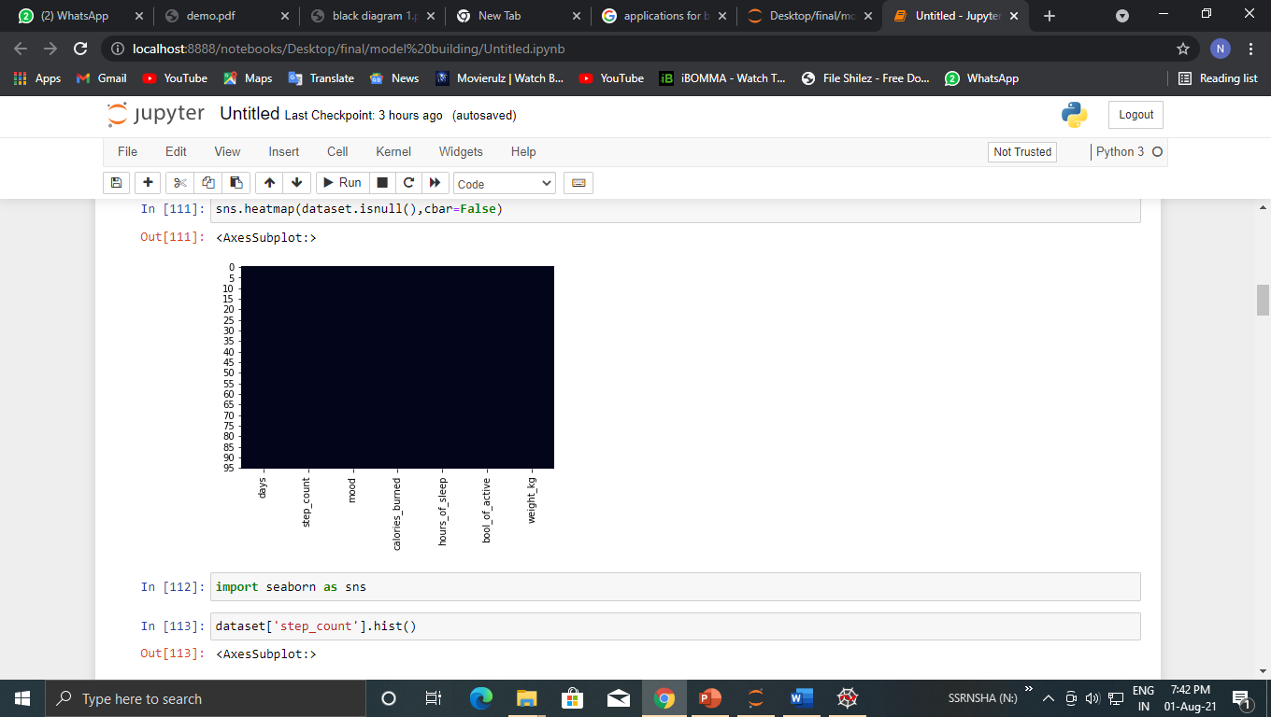

Slide 11
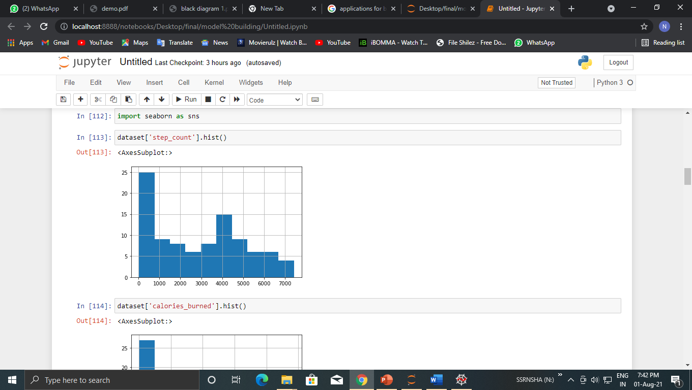

Slide 12
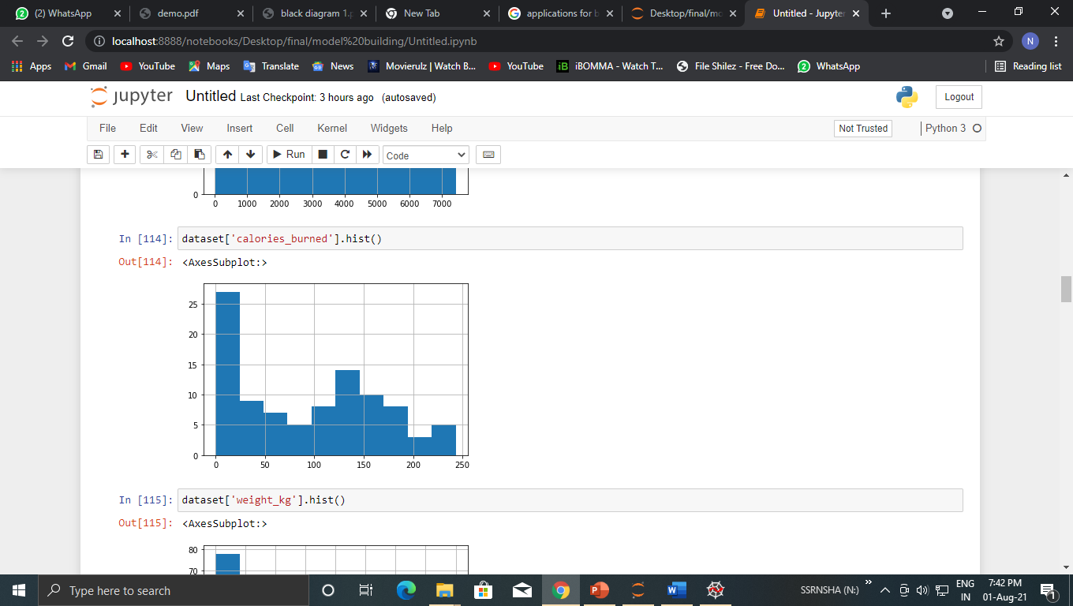

Slide 13
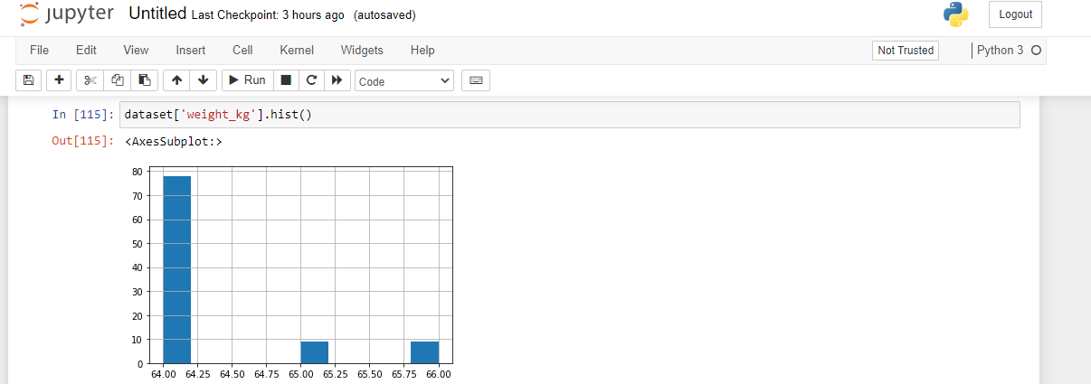

Slide 14
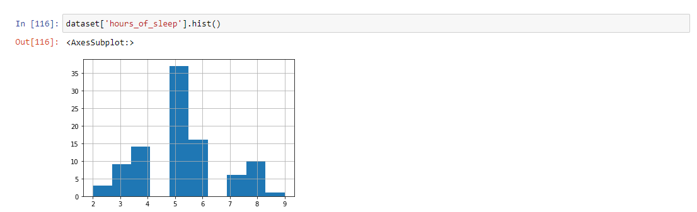

Slide 15
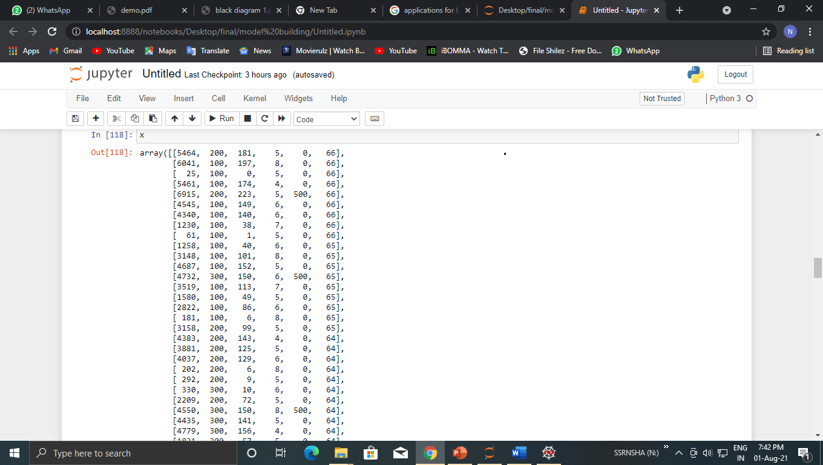

Slide 17
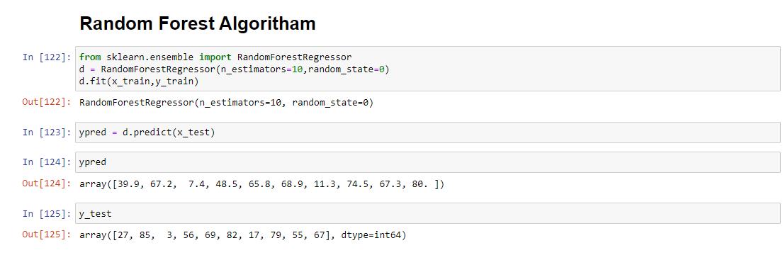

Slide 18
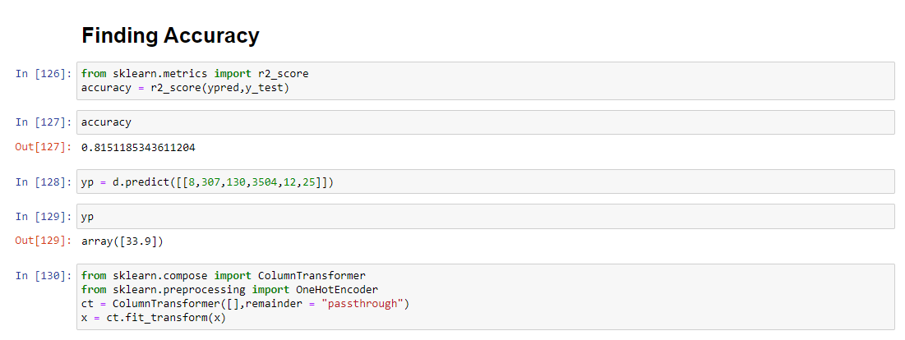

Slide 19
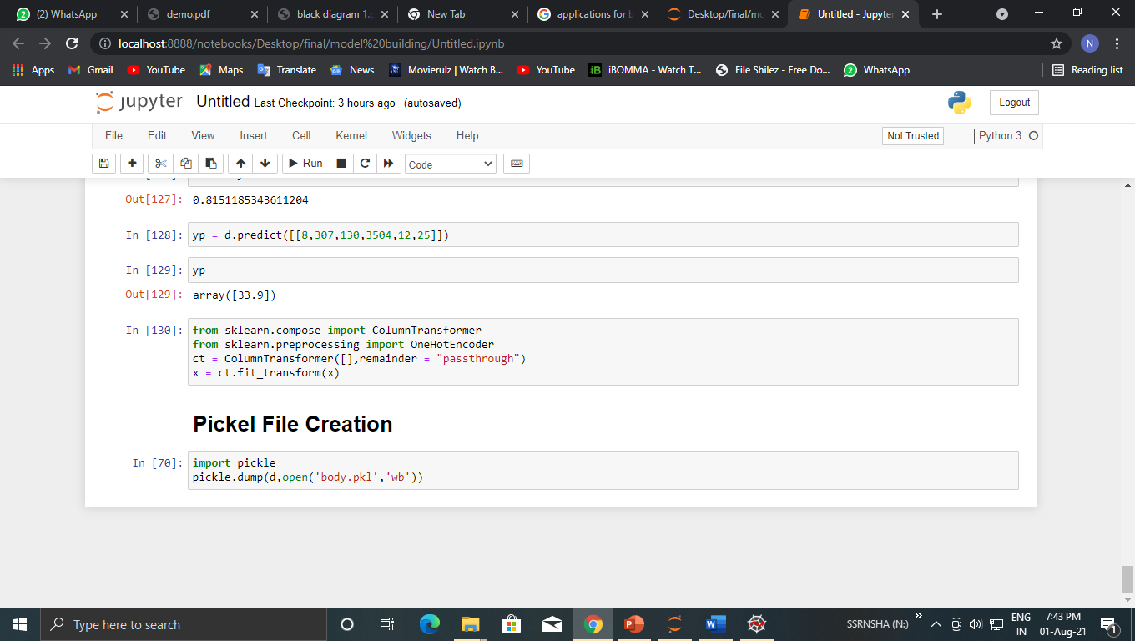

Slide 20
ADVANTAGES AND DISADVANTAGES
Advantages
reduce your risk of a heart attack.
manage your weight better.
have a lower blood cholesterol level.
lower the risk of type 2 diabetes and some cancers.
have lower blood pressure.
have stronger bones, muscles and joints and lower risk of developing osteoporosis.
lower your risk of falls.
Disadvanges
Exercise is addictive. ...
Exercise Hurts The Heart. ...
Exercise is associated with body perception disorders. ...
Exercise can break up families. ...
Exercise can cause diabetes. ...
Exercise causes inflammation. ...
Exercise is stressful. ...
Exercise causes premature aging.

Slide 21
Applications
we can also use this model to predict , different sectors like business, bank, salaries etc...
This system can be used in single gyms.
This system can be used to manage a chain of gyms.

Slide 22
FUTURE SCOPE
This Decision Tree Regression model can also be used in the future predictions like weather forecast, job prediction, salary prediction etc. In further study, we will try to conduct experiments on larger data sets or try to tune the model so as to achieve the state -of-art performance of the model and a great UI support system making it complete web application

Slide 23
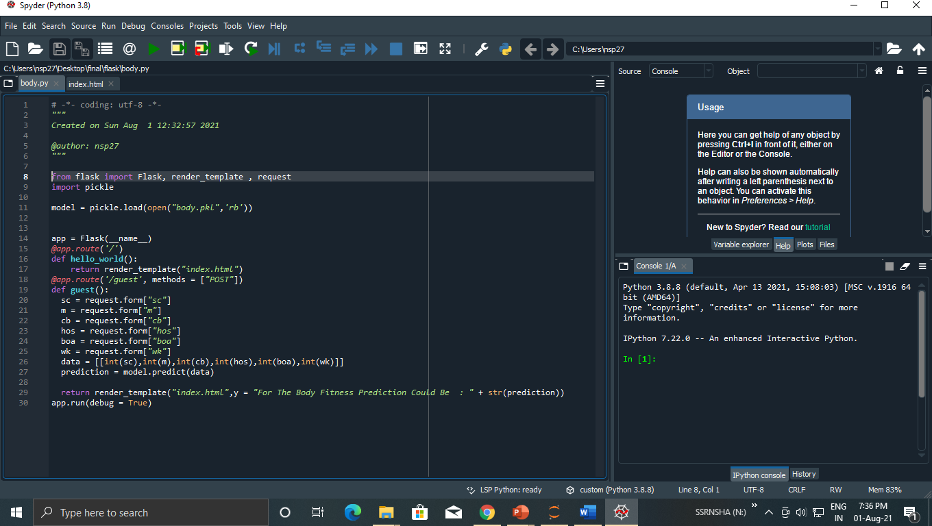

Slide 24
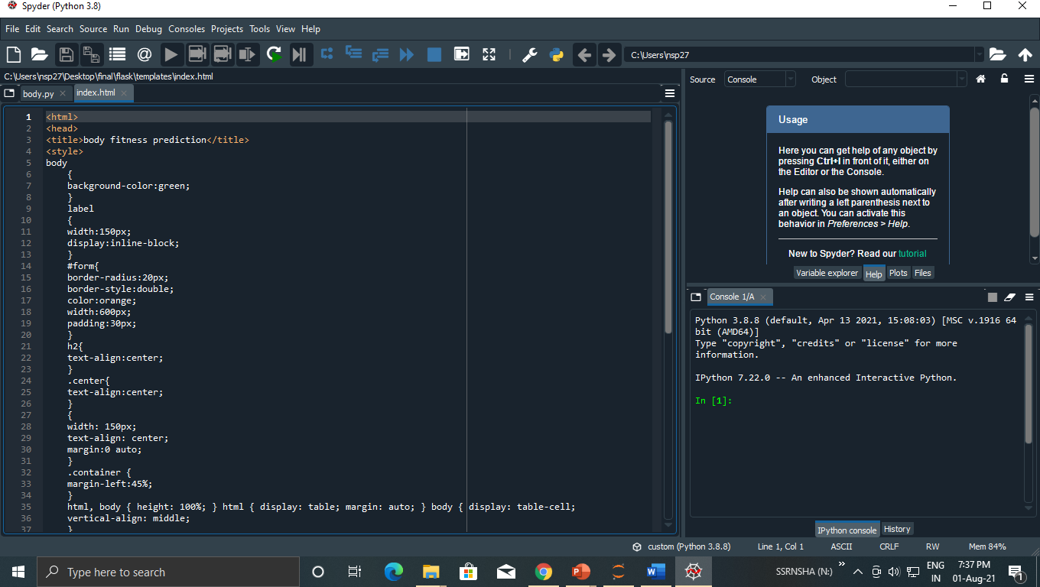

Slide 25
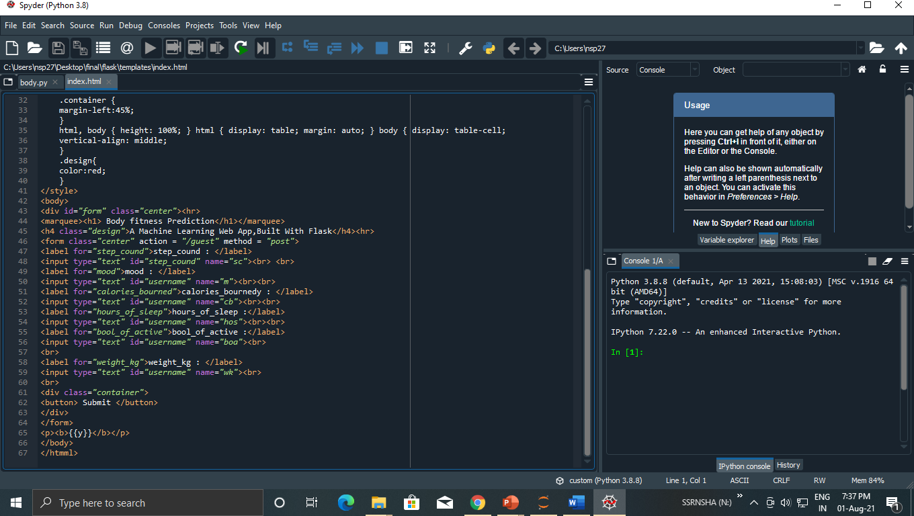

Slide 26
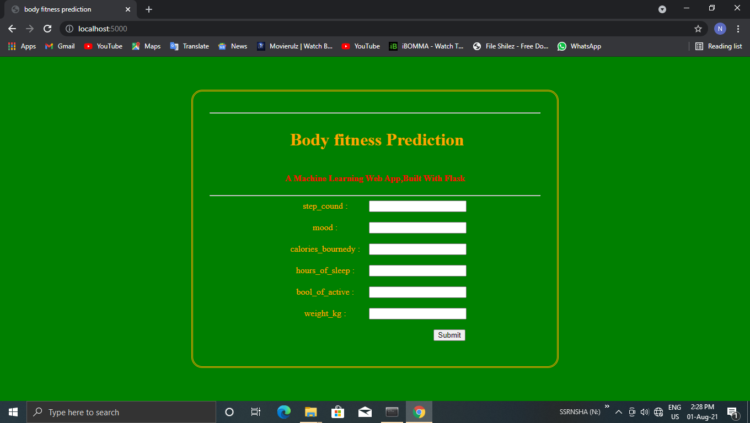

Slide 27
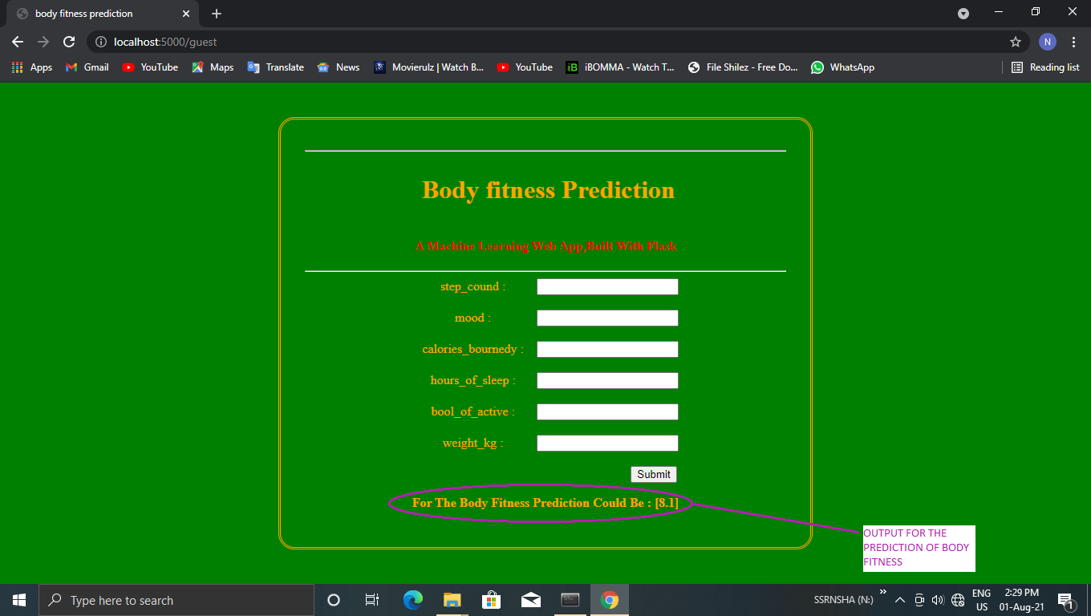

Slide 28
THANKING YOU

